Slide 1

PickZ
-Your Ultimate Gadget Companion
"Because Team Work is Dream Work"

Slide 2





Information Overload
The internet provides an abundance of choices for any given product. When there are too many options, it can be overwhelming for a consumer to make a decision.
Price Discrepancies
Problems we Identified
Differing prices for identical mobiles or laptops on various websites can be frustrating for users seeking the best deal.
Complex Navigation
Complex website interfaces and unclear navigation can hinder users, leading to frustration as they struggle to quickly find the information they need
Limited Filters and Sorting Options
Sorting through a wealth of information across various websites makes choosing the right mobiles or laptops challenging for users

Slide 3
SOLUTION FOR THESE PROBLEMS
Unified
Information
Price Consistency
Our website aggregates data, providing a one-stop platform for comprehensive and clear information on mobiles and laptops, making comparisons straightforward.
Enjoy peace of mind with consistent pricing across our platform, eliminating the frustration of varying prices. Our commitment to transparency ensures users find the best deals without surprises.
03
01
3D
Model
Intuitive
Navigation
Creating a 360-degree environment for an electronics product involves creating a 3D model 360-Degree View: Ensure the 3D model is designed to be viewed from all angles. This includes modeling the back, sides, and any other relevant details.
We've designed an easy-to-navigate interface, ensuring users can effortlessly browse and locate the details they need without the hassle of confusing menus or layouts.
02
04

Slide 4

Flowchart
User
User Accesses Website
Category Selection
Comparison Feature
User-Friendly Website
User selects a specific category (e.g., Laptops) apply filters (e.g., price range, brand).
User selects multiple products and activates the comparison feature.
User can easily interact with our website using chatbot.
User navigates to the website through a web browser.
User lands on the homepage displaying categories: Laptops, Tablets, Phones, and Audio Products
User clicks on a specific product to view detailed information (specifications, prices, reviews).
Our website provides information for people of different fields like for student, etc.
Different Web-Pages are designed for different items ,user can mail/message us for clarifying their doubts.

Slide 5


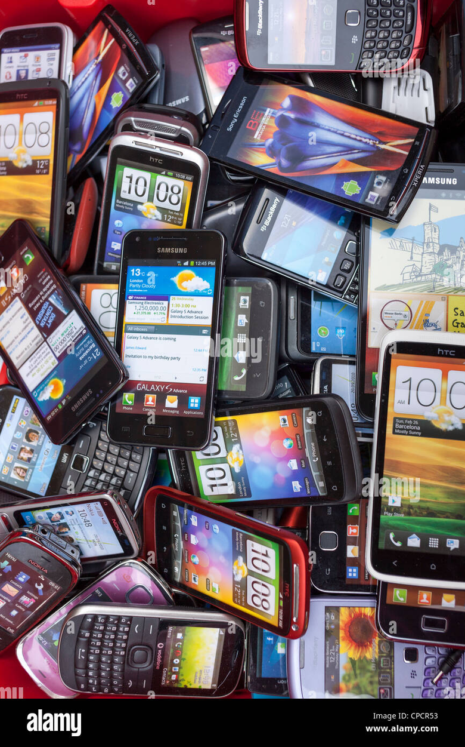
1.)Mobile Phones
1.) Introduction
We have options for you in brands like Apple, Samsung, Mi, Motorola, Oneplus ,and many more.
2.) User Interface
Compare user interfaces, emphasizing ease of use, intuitive design, and user customization.

Slide 6

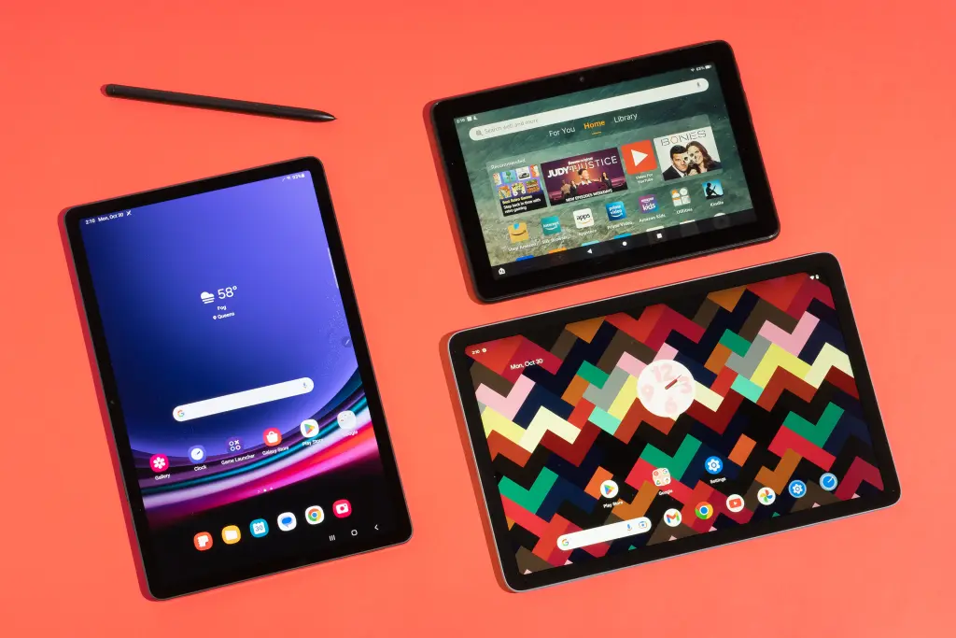
2.)Tablets
1.) Introduction
Welcome to our Website where we'll explore
the diverse landscape of these portable devices and compare their features.
2.) Design and Form Factor
Compare the design elements of popular tablets, highlighting factors like size, weight, and build materials.

Slide 7
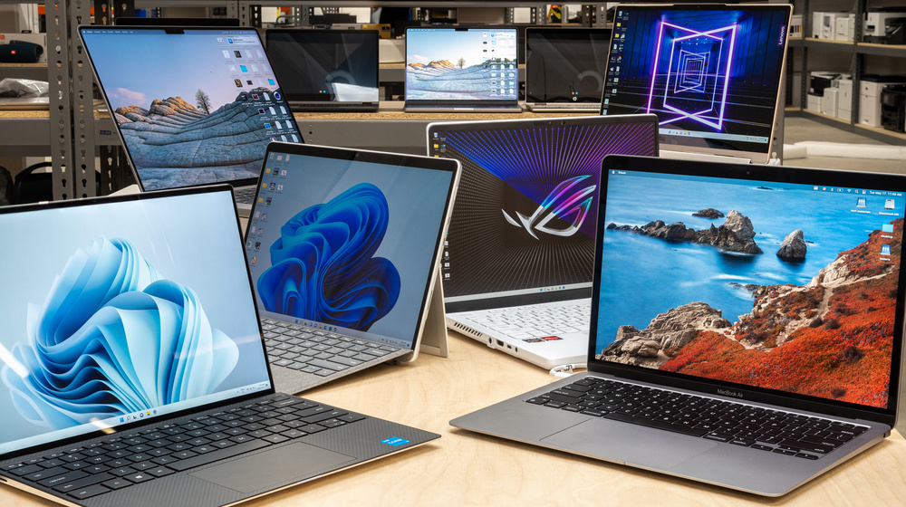
3.Laptops
Analyze display technologies, including resolutions, refresh rates, and color accuracy to understand their impact on visual experience
1.)Display Technology
2.)Operating Systems
Compare user experiences across different operating systems (Windows, macOS) and discuss their strengths and limitations.

Slide 8
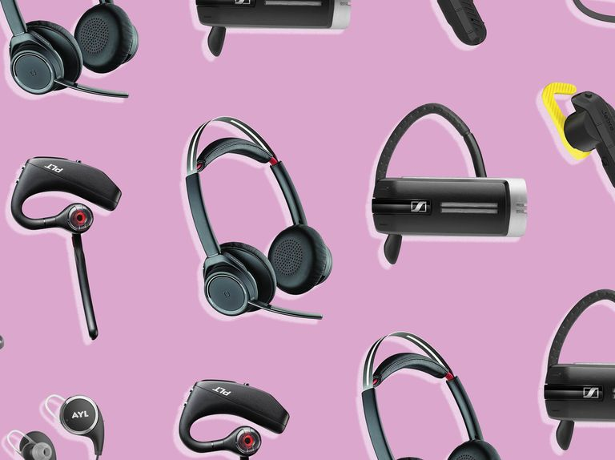
4)Audio Products
1.) Design and Form Factor
We can help you choose the best Audio Product to match your vibe, you can choose from brands like JBL, Sony, Boat and many more.
.
2.) Durability and Build Quality
Assess the durability and build quality of audio products, considering materials used, hinge mechanisms, and overall construction.

Slide 9






Tech Stack
Frontend
Backend
Designing
Deployment

Slide 10
Future Aspects
Integration of machine learning to provide better information to the users.
1)Integration Of Machine Learning
Using 3-D models to provide users better understanding of the product in real world scenario.
2)AR/VR Integration
Integration of AI chatbot so that user can interact in a more friendly way with the users .
3)Implementation of AI

Slide 11




Our Team
Aayushker Singh
Gaurav Daultani
Akshat Srivastav
Abhishek(Mentor)
Aayush Raghav
Anshika Agarwal
Ishika
Bhavya Agarwal

Slide 12

Thank You
"Because Team Work is Dream Work"
Team: Keyboard Warriors

